Slide 1

Chapter 9 Of CSTE test Book Of Knowledge
Testing Internal Control
  By Joel Robinson
  What is internal Control?
  Security!
  Not just penetrations, hacking, and denial of service.
  Its CEO giving false information.
  SOX Sarbanes Oxley Act requires the CEO and CFO must personally attest to the adequacy of their internal controls. Criminal charges can be brought.
  Perp walk!

Slide 2
Principles & Concepts of IC
  Internal Control:
  Used to be only accountants cared. Now engineers can be criminally liable for software that is used to intentionally deceive and defraud.
  Five bean-counter watchdog groups got together and formed a group to create a framework:
  COSO – Committee of Sponsoring Organizations
  "…A process, effected by an organization’s Board of Directors, management and other personnel, designed to provide reasonable assurance regarding the achievement of objectives in the following categories:

Slide 3
COSO
4 key terms in IC
RISK – probability undesirable event
EXPOSURE – amount of loss if undesirable event occurs
THREAT – Specific event that might cause undesirable event
CONTROL: Anything that reduces impact of risk
Software testers are responsible to test:
Effectiveness and efficiency of operations
Reliability of financial reporting
Compliance with applicable laws & regs
This entails knowing something of the SOX laws.

Slide 4

Test Questions:
Who is COSO?
What is Internal Control in one word?
What are 4 key terms of IC?
What is SOX?
Give an Example of IC? Page 420
Fill in your answers

Slide 5
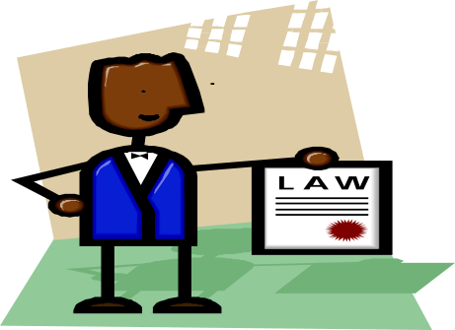
Responsibilities
Internal Auditors
“… an independent, objective assurance and consulting activity designed to add value and improve an organization’s operations.
It helps an organization accomplish its objectives by bringing a systematic, disciplined approach to evaluate and improve the effectiveness of risk management, control, and governance processes.”
What do auditors do?
Identify and manage risk
Monitor risk management systems
Assist in maintaining controls
Evaluate governance, operations, and information systems regarding
  reliability and integrity of financial and operational information
  Safeguarding assets
  Operations
  Compliance with laws

Slide 6
Auditors are like testers...
Auditors are like testers...
  Objective, independent, code of ethics, don't usually report to operations or development, issue reports and findings, evaluate the effectiveness of systems
Auditors are not like testers...
  Potential and actual conflicts of interest, bias, assigned to test areas where they had prior operating or developmental assignments.

Slide 7
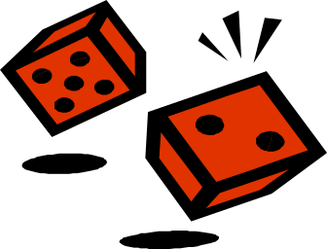

Risk vs. Control
Sole purpose of control is to.... reduce risk.
Risk = frequency x occurrence (Expected value)
Requirements in controls are usually stated postively, not negatively, thus:
  All shipped products shall be invoiced,
        Not
  Reduce risk of not invoicing for shipped products.

Slide 8
What are SOX major provisions?
  http://en.wikipedia.org/wiki/Sarbanes-Oxley_Act
  •Certification of ··financial reports by CEO and CFO
  •Ban on personal loans to any Executive Officer and Director
  •Accelerated reporting of ··trades by insiders
  •Prohibition on insider trades during ··pension fund blackout periods
  •Public reporting of CEO and CFO ··compensation and ··profits
  •Additional disclosure
  •Auditor independence, including outright bans on certain types of work and pre-certification by the company's ··Audit Committee of all other non-audit work
  •Criminal and civil penalties for violations of··securities law
  •Significantly longer jail sentences and larger fines for corporate executives who knowingly and willfully misstate ··financial statements.
  •Prohibition on audit firms providing extra "value-added" services to their clients including (such as consulting) unrelated to their audit work.
  •A requirement that publicly traded companies furnish independent annual audit reports on the existence and condition (i.e., reliability) of internal controls as they relate to financial reporting.

Slide 9

Q & A
Name 5 major provisions of SOX
Sole purpose of control is to ....
Risk is ( ) x ( )
What do auditors do?
Answers

Slide 10
Environmental vs Transaction Controls
Environmental (general)
Means by which management manages the organization
Policies, org structure, methods of hiring, training, rewarding, supervising
Day-to-day processes
  Password policies
  Equipment loans
Transaction
Minimize business risks during business transaction processing.
1. system that process business transactions (perform financial exchange)
2. system that controls the processing of business transactions (edit/filter inputs)

Slide 11

Examples:
Environmental Transaction
Review of a new IT system. Review team examines requests, makes decisions, monitors implementation.
Limiting access to computers via passwords, domains, need-to-know, restricted transactions, read-only,
Divide control of transactions into those that
Initiate & authorize transaction
Record the transaction
Safeguard results & assets
Bank teller night deposit:
  a. open deposit box
  b. record the receipts
  c. deposit the receipts

Slide 12
Goals of transaction processing controls:
  Assure that all authorized transactions are completely processed once and only once.
  Assure that transaction data is complete and accurate.
  Assure that transaction processing is correct and appropriate to the circumstances.
  Assure that processing results are utilized for the intended benefits.
  Assure that the application can continue to function.
  Ok I have 12 slides already and a zillion pages to go, so the level of detail will decrease starting now.

Slide 13

Prevent, Detect, Correct
  Preventive controls include standards, training, segregation of duties, authorization, forms design, pre-numbered forms, documentation, passwords, consistency of operations, etc.
  source data authorization
  data input
  source data preparation
  turnaround docuemnts
  pre-numbered forms
  Input validation,
  computer updating of files,
  controls over processing

Slide 14

Prevent, Detect, Correct
  Defective controls alert individuals to problems
  Data transmission – safeguard
  Control register - log
  Control totals – batch results
  Documentation and testing
  Output checks - reconcile

Slide 15

Prevent, Detect, Correct
  Once errors have been made you can:
  - reject all data,
  - prepare error input record or report
  - Submit corrected transaction

Slide 16
Internal Control Models
  COSO Enterprise Risk Management ERM Model
  Provide direction to companies to enhance risk management
  page 435
  Internal Environment
  Objective setting
  Event Identification
  Risk Assessment
  Risk Response
  Control Activities
  Information & communication
  Monitoring

Slide 17


  Internal Environment - Management sets risk and appetite.
  Objective Setting - Objectives must exist before management can act
  Event Identification - Potential events must be identified.
  Risk Assessment - Identified risks are analyzed.
  Risk Response - Management selects an approach or set of actions
  Control Activities - Policies and procedures are established.
  Information and Communication - Relevant information is identified, captured and communicated
  Monitoring - The entire enterprise risk management process must be monitored, and modifications made as necessary.

Slide 18
Control Activities
COSO Internal Control Framework Model
Control environment – people, places
Risk Assessment – areas to analyze
Control activities – policies & procedures
Information & communications capture and exchange data
Monitoring and Modifying
CobiT IT Security Framework Model
For IT security mostly
1. Plan and Organize – define strategy
2. Acquire & implement – identify automated parts
3. Deliver & support – manage problems
4. Monitor processes & practices

Slide 19
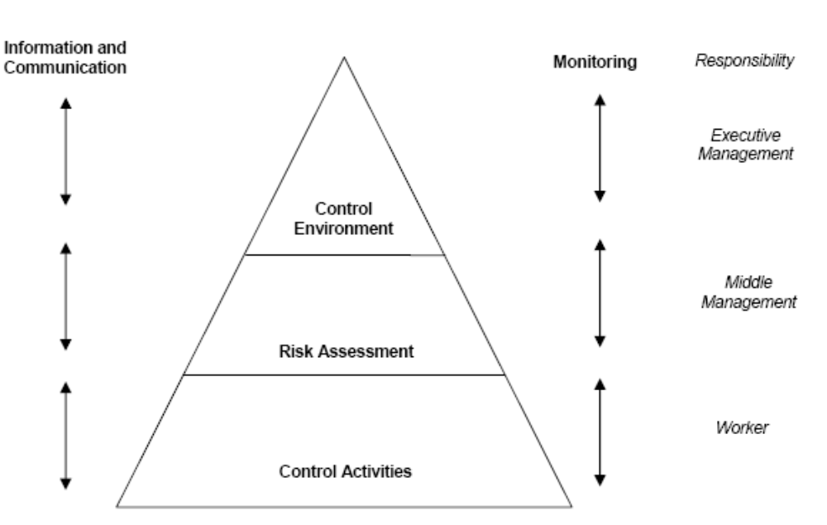

Slide 20
Testing Internal Controls
Auditors assess the adequacy of internal controls... all five components of COSO internal control model (previous slide)
Testers test is assure control requirements are testable, then test to determine whether controls were implemented as specified
  Are the requirements defined
  Are the controls in place and working
  Are the 'enterprise' controls in place and working
    (controls for entire corporation/division/enterprise)

Slide 21

Risk Assessment p 441
Perform Enterprise risk assessment
Inherent & residual risks
  No matter what
  Remaining risk after done all you can
Estimating likelihood on impact
Qualitative and Quantitative methods
Correlate with events, sequences of events

Slide 22
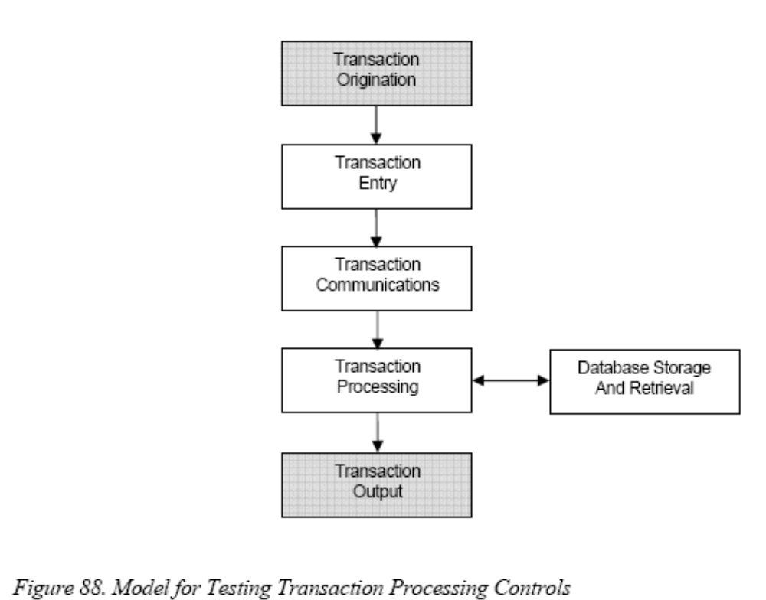

Test Transaction Processing Controls

Slide 23

Testing Security Controls
1. Understand the points where security is most frequently penetrated; and understand the difference between accidental and intentional loss.
2. Build a penetration point matrix to identify software vulnerabilities;
investigate the adequacy of the security controls at the point of greatest potential penetration.
3. Assess the security awareness training program to assure the stakeholders in security are aware of their security responsibilities.
4. Understand the attributes of an effective security control.
5. Understand the process for selecting techniques to test security.

Slide 24
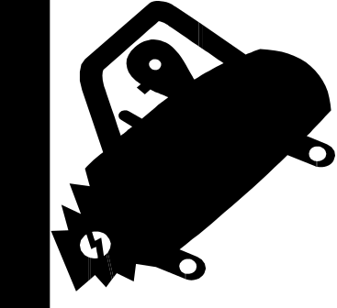
Vulnerable areas
Why do we spend so much time protecting central processors and so little time protecting data and reports p 445
Accidental vs Intentional losses
  Assume it was an accident
  Assume it was hardware malfunction
  Assume it was data entry
  Assume it was another organization
  Assume it was the programming staff
  Maybe it was me

Slide 25
Penetration Matrix: Where to test
Controlling people & their activities by activities, usually via a division of responsibilities
Select appropriate activities - Usually access to computer environments, SW development activities, and computer operations
  Interfaces activities- Software packages, Privileged users, Vendor access, Development and maintenance apps
  Development activities – policies, training, DB administration, communications, documentation
  Operational Activities – Processing, media, data, and SW libraries, error handling, disaster planning, privileged commands

Slide 26
10 points of Controlling Transaction Processing
1. Origination – where did X start?
2. Authorization – who approved X?
3. Data entry – How did X get entered?
4. Communication – how did X get here?
5. Storage – where is X now?
6. Processed – How was X processed?
7. Retrieval – Can I get a copy of X?
8. Output – Is there an X report/hard copy?
9. Usage – Who gets X output?
10. Destruction – Should we keep X?

Slide 27

Penetration Characteristics
Build a wall
  Keep everything out,
  wall is same height everywhere
Locate security where penetration risk highest
  Weakest point
  Point with greatest value to attacker
  Least controlled activity

Slide 28

Make a Penetration Point matrix
Not likely anyone will ever do this, but it is on pages 455-457 It has 10 transaction control points as rows and activities as columns.
Make a matrix for interface activities, development activities, and operation activities

Slide 29
Task 3 Assess Security Training
Compare yourself with world-class programs if you want to assess the adequacy of your organization (or just want to feel really bad about your company) Train everyone involved to the degree they are involved.
People are greatest risk, weakest link, most likely to be voted off the island. Social engineering issues etc.
Create security awareness policy – CIO / Director
Develop strategy to implement policy – appropriate to your company risks & needs.
Assign roles to appropriate individuals

Slide 30
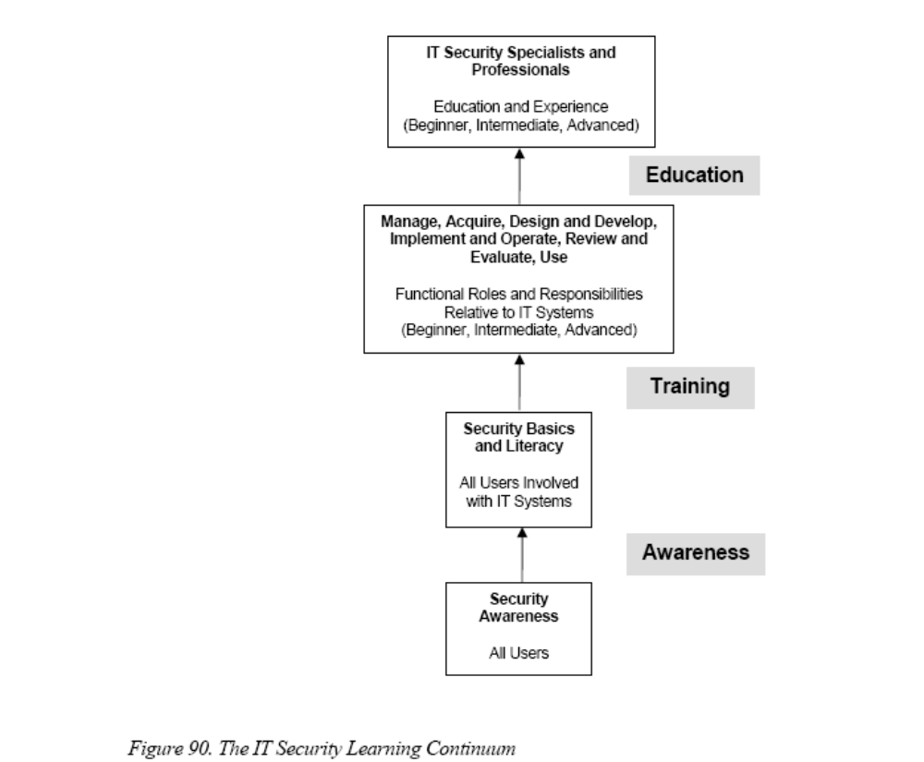

Slide 31

Learning is a Continuum
Probably on the test: p462
Starts with awareness
Builds to training
Evolves into education
Security awareness is not training. Efforts are designed to change behavior or reinforce good security practices... to focus attention on an issue
Training strives to produce relevant and needed skills and competencies to perform a specific function.
Education integrates all skills and competencies into a common bodyof knowledge, adds multi-disciplinary study, and produces individuals capable of vision and pro-active response

Slide 32

Professionalism
Professional development is intended to ensure that users, from beginner to the career security
professional, possess a required level of knowledge and competence necessary for their roles.
Professional development validates skills through certification. Such development and successful
certification can be termed “professionalization.”

Slide 33
Assign Roles & Responsibilies
IT Director CIO – Gives security it's priority resources, and budget
IT Security Program Manager – Tactical level leadership for awareness and training
IT Managers – Comply with awareness and training mandates
Users – Implement policies and procedures

Slide 34

Task 4 Understand effective security controls
1. simple
2. fail safe
3. complete mediation – enforce access
4. open design – not rely on hidden code
5. separation of privileges
6. Psychologically acceptable - training
7. Layered defense – like an onion
8. Compromise recording - logs

Slide 35

Selecting Test Techniques
Network scanning
Vulnerability scanning
Password cracking
Log review
Integrity checkers
Virus detection
War dialing
War driving
Penetration testing
Understand the testing technique
Select technique based on strengths and weaknesses
Determine frequency of testing Good chart on page 470

